Slide 1
Ask Weber
Session 3
Topic 6
askweber.github.io

Slide 2
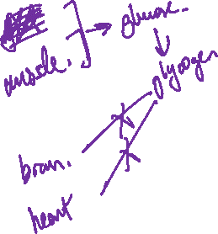
Homeostasis
1. Why is glucose homeostasis important for the brain’s function
2. What is an implication of low glycogen stores in the brain for

Slide 3
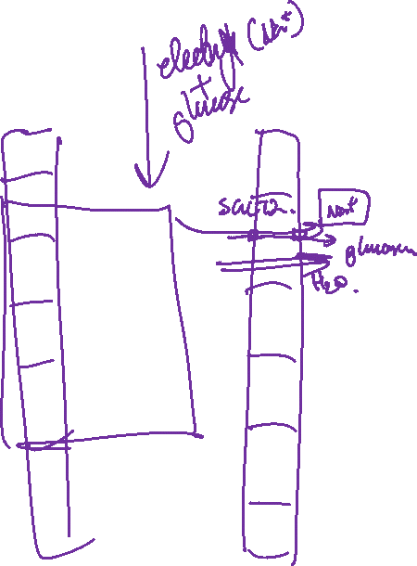
When drinking Gatorade, on the bottle it says that the drink is ‘scientifically proven’. Theoretically, hydralyte(a fluid replacement solution for diarrhoea) would also be ‘scientifically proven’ –the basis behind the two would be very similar, if not the same. Both essentially are sugar and electrolyte solutions. Why is it that we drink sugar/salt drinks to rehydrate (note that intestinal absorption of salt and sugar also results in better water absorption)

Slide 4
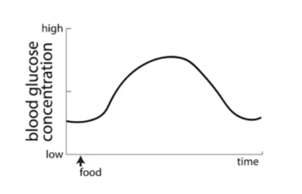
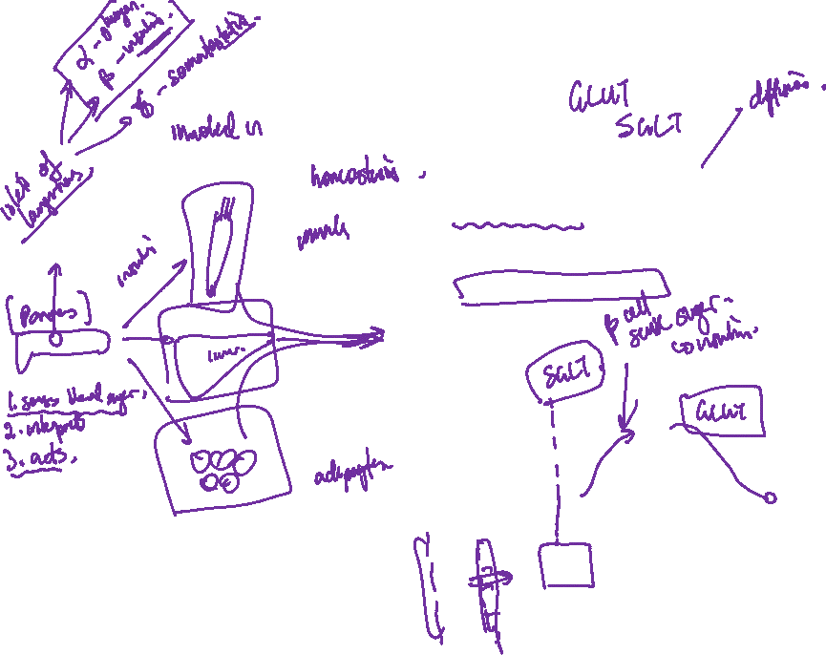
Which organs are responsible for glucose?
Consider the following figure – explain the process allowing the increasing arm of the glucose concentration graph? Which transporter group is responsible for this?
Similarly, which transporters are for the decreasing concentration arm of this graph?

Slide 5
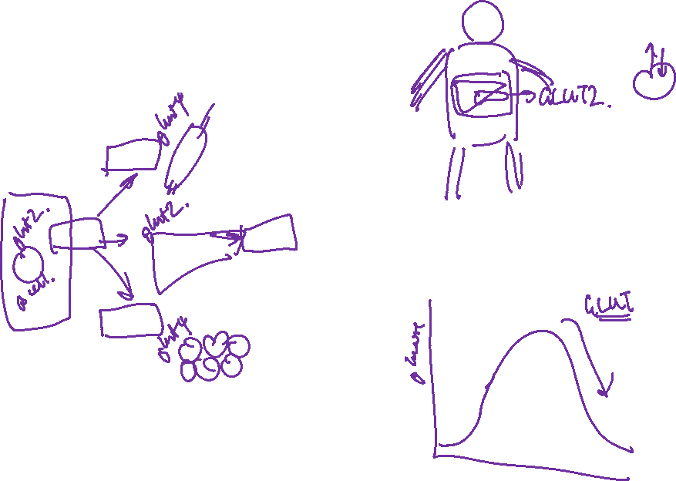
Once glucose is absorbed into the blood stream, it can be stored/used in muscle, fat, liver and brain. Which organs have the GLUT4 transporter?

